Slide 1
Skin Disease Detection using Convolution Neural Network
1.Mythreyi Nalluri, 700741075
2. Rithvik Sena Reddy Malepally, 700737712
3. Vamshi Krishna Rapolu, 700742210
4. Varna Nemulla, 700744920

Slide 2
Role/Responsibilities and Contribution in project
Problem description and dataset formation: Images for the dataset are downloaded and then they are preprocessed using the python CV2 library with various image processing techniques. Mythreyi Nalluri, 700741075 did this task.
Feature Extraction for 2 classes of image (Melanoma & Benign keratosis): Applied the preprocessing techniques available in the pillow module and resized the images and applied the contrasting adjustments. Rithvik Sena Reddy Malepally, 700737712 did this task.
Feature Extraction for 2 classes of image(Basal cell carcinoma, Actinic keratosis, and Dermatofibroma): Applied the preprocessing techniques available in the pillow module and resized the images, and applied the contrasting adjustments. Vamshi Krishna Rapolu, 700742210 did this task.
Using the flask module in Python is used to build the web app and also the screens and the design of the pages is carried out by Varna Nemulla, 700744920

Slide 3
Motivation:
Skin Cancer is an emerging global health problem considering the increasing prevalence of harmful ultraviolet rays in the earth’s environment.
A proper diagnosis can result in proper medication that can reduce the miseries of the people suffering and create awareness.
In this research, we have tried to develop a prototype to detect skin diseases using neural networks.

Slide 4
Objectives:
To design an effective neural network model that best classifies the given input user image to the most accurate skin disease.
To develop a UI with ease of use for the users using the programming components and modules available in Python.

Slide 5
Related work
The amalgamation of technology with health care results in rapid development in image processing techniques to aid the medical field. Application of digital image-based equipment such as Computed Tomography (CT), Digital Subtraction Angiography (DSA), and Magnetic Resonance Imaging (MRI) help in accurate diagnosis. Many researchers have worked for detection of skin diseases so far. A brief literature survey is given below.
Ercal et al. [1] used an adaptive color metric from the RGB planes. It helps in discriminating the tumor and the background. Image segmentation is performed using a suitable coordinate transformation. Borders are drawn by extracting the tumor portion from the segmented image. This was an effective method to find tumors diagnosis.
S. Pari et al., [2] used deep convolutional neural networks, image classification algorithms with data augmentation to successfully investigate automatic detection of dermoscopic patterns and skin lesion analysis.
Ganster et al. [3] developed a computer-based system for image analysis acquired through ELM. Basic segmentation algorithms with fusion strategy are used to get the binary mask of skin lesion. The malignancy of lesion is calculated based upon shape and radiometric features. The local and global parameters are also considered for better results. The system improves the early detection of malignant melanoma.

Slide 6
Problem Statement
Skin is the one of the most important organ in the human body. It acts as a shield to protect our internal body from getting damaged. But this important part of the human body can be affected by serious infections caused by some fungi or viruses or even dust too. Around the world, millions of people suffer from various skin diseases. From acne problems to eczema, people suffer a lot. Sometimes a small boil on the skin can turn into a severe issue or even an infection that will cause a major health issue.
A proper diagnosis can reduce the miseries of the people and helps to create awareness. So, we have wanted to develop a prototype to detect skin diseases using neural networks. In the choice of neural networks, we have chosen CNN which abbreviates as a convolutional neural network. Here, we have made a classifier prototype that will give the class of skin disease by analyzing the image and matching the image from its previous training data to produce maximum accuracy. The model is used to classify five classes of skin disease named eczema hand, eczema nummular, eczema subcute, lichen simplex, Stasis dermatitis, and ulcers.

Slide 7
Proposed Solution
Our approach started with loading of the dataset and then the data augmentation continued by creating a neural network and training the network. The flow is as below.
A. Dataset Collection: The pictures from Dermnet. We have considered skin infection pictures with the natural parts. It has been seen that the proposed framework yield exactness differs as for skin illnesses.
B. Data augmentation Preparation: To avoid overfitting we are extending our data using data augmentation. In any case, our profound neural classifier needs a comparable informational index for preparing and testing the informational index. So we set the pixels into 100 X 100.
C. Splitting data for training and validation: Here in this section we used the sklearn module in python to split our numerical tabular dataset into 2 with 80 percent as training data and remaining as validation data.
D. Model building: After the segregation of the image data into training and validation set using image data generators, we have focused on model building. We are building a neural network model with 13 layers in it

Slide 8
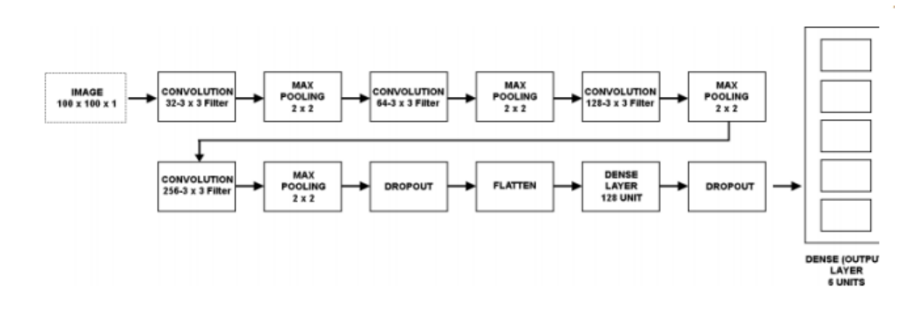
CNN Architecture

Slide 9
Results/Simulations
The digitalized skin ailment pictures were caught by the camera and preparing strategies were applied to these information pictures. Picture handling is a strategy that can be partitioned into various classes: one of these is Image Compression another picture upgrade and the latter is the reclamation, and estimation extraction. We trust that this model will be created as a genuine application for our clinical science for the government assistance of patients. It will be so encouraging for created nations to identify their sicknesses so they can concern prior and can make legitimate strides for their sound skin.

Slide 10
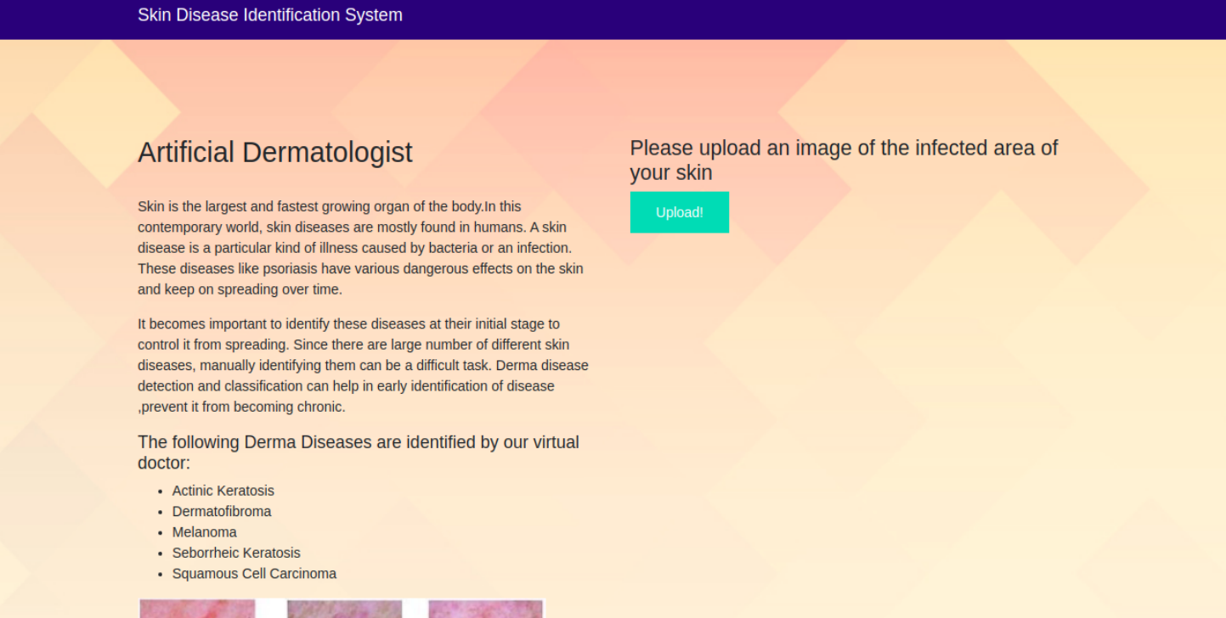
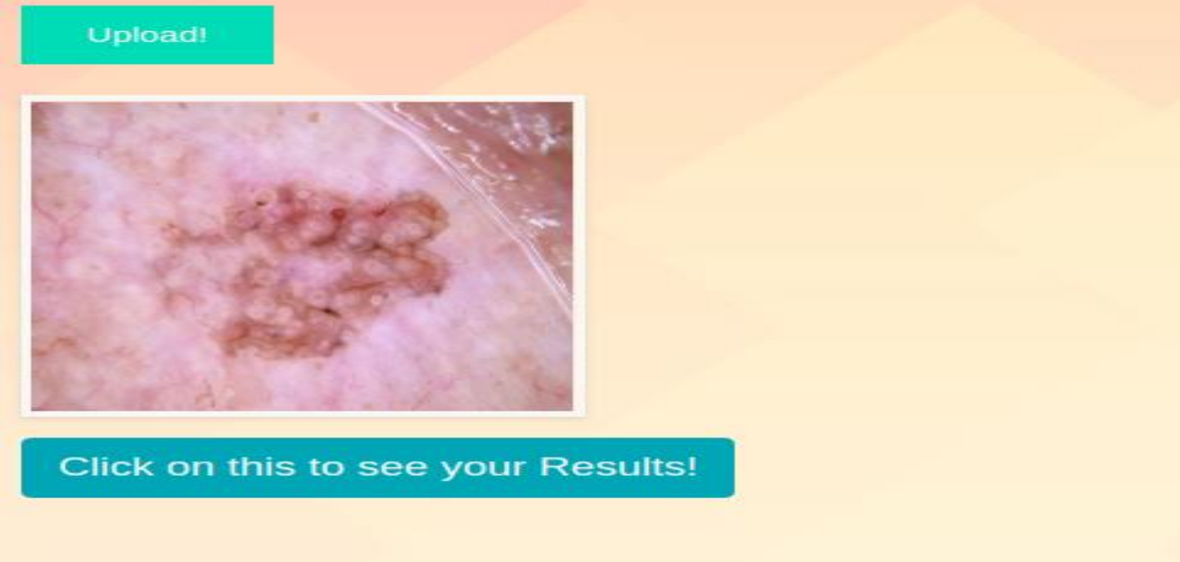
Input

Slide 11
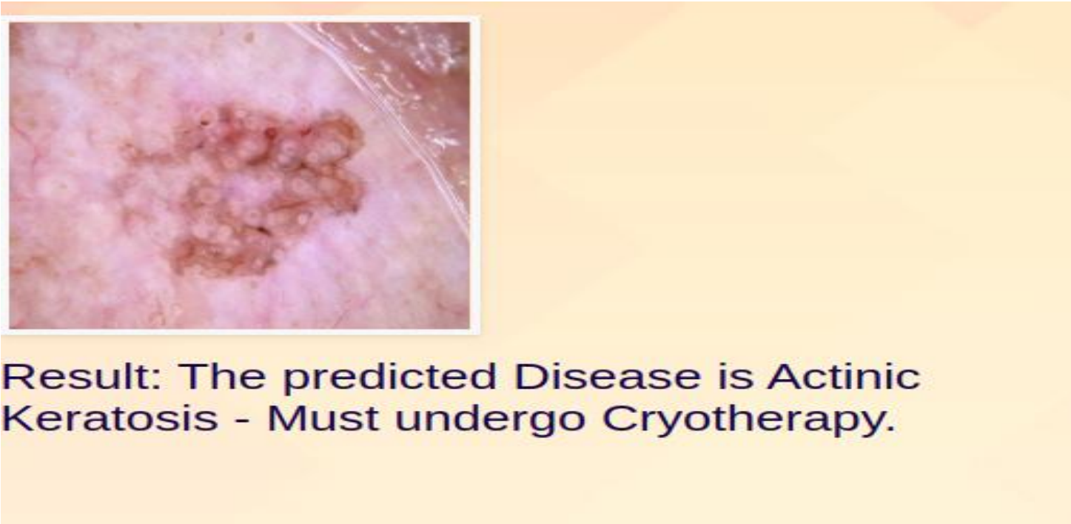
Output

Slide 12
References
[1]. Goceri, E. (2019). Skin disease diagnosis from photographs using deep learning. In VipIMAGE 2019: Proceedings of the VII ECCOMAS Thematic Conference on Computational Vision and Medical Image Processing, October 16– 18, 2019, Porto, Portugal (pp. 239-246). Springer International Publishing.
[2]. Li, H., Pan, Y., Zhao, J., & Zhang, L. (2021). Skin disease diagnosis with deep learning: a review. Neurocomputing, 464, 364-393.
[3]. Inthiyaz, S., Altahan, B. R., Ahammad, S. H., Rajesh, V., Kalangi, R. R., Smirani, L. K., ... & Rashed, A. N. Z. (2023). Skin disease detection using deep learning. Advances in Engineering Software, 175, 103361.
[4]. Li, L. F., Wang, X., Hu, W. J., Xiong, N. N., Du, Y. X., & Li, B. S. (2020). Deep learning in skin disease image recognition: A review. IEEE Access, 8, 208264-208280. [5]. Kumar, V. B., Kumar, S. S., & Saboo, V. (2016, September). Dermatological disease detection using image processing and machine learning. In 2016 Third International Conference on Artificial Intelligence and Pattern Recognition (AIPR) (pp. 1-6). IEEE.

Slide 13
[6]. Anand, V., Gupta, S., & Koundal, D. (2022). Skin disease diagnosis: challenges and opportunities. In Proceedings of Second Doctoral Symposium on Computational Intelligence: DoSCI 2021 (pp. 449-459). Springer Singapore.
[7]. Rathod, J., Waghmode, V., Sodha, A., & Bhavathankar, P. (2018, March). Diagnosis of skin diseases using Convolutional Neural Networks. In 2018 second international conference on electronics, communication and aerospace technology (ICECA) (pp. 1048-1051). IEEE.
[8]. Rimi, T. A., Sultana, N., & Foysal, M. F. A. (2020, May). Derm-NN: skin diseases detection using convolutional neural network. In 2020 4th International Conference on Intelligent Computing and Control Systems (ICICCS) (pp. 1205- 1209). IEEE.
[9] E. Balestrieri, F. Lamonaca, S. Lembo, G. Miele, F. Cusano, and G. A. De Cristofaro, “Automatic psoriasis assessment methods: current scenario and perspectives from a Metrologic point of view,” IEEE, 2019, pp. 1–6.
[10 ] Z. Ge, S. Demyanov, R. Chakravorty, A. Bowling, and R. Garnavi, “Skin disease recognition using deep saliency features and multimodal learning of dermoscopy and clinical images,” in International Conference on Medical Image Computing and Computer-Assisted Intervention. Springer, 2017, pp. 250–258.

